Slide 1
Portfolio Optimization
Submitted by: Submitted To:
HarshVardhan Agrawal Dr. hande benson
Sumit Rane
Amol Takkalki
Akshata Tare

Slide 2

Data
Data I : S&P 500 , 24 Stocks
Data II : S&P 500 , 60 Stocks
(Extension to test computation)
Risk free rate (as of Nov 2014)
Series I bond: 1.48 % annualized return
Fixed rate
Inflation adjusted 6 monthly return: 0.68%

Slide 3
How to Quantify Risk ?
Markowitz: Capital asset pricing model
Mean variance method
Maximize Return or minimize risk
Return: Average closing price over 24 months
Risk: Covariance between the stocks.

Slide 4
Recommended Optimal model
Investment Summary
 | High Risk | Optimal | Low Risk
Total investment | $10,000 | $10,000 | $10,000
Risky Assets investment | $6,998 | $4,999 | $2,999
Risk Free Assets | $3,000 | $5,000 | $7,000
Trading cost | $2 | $1.42 | $0.85
Return 60 Stocks | $10,215.44 | $10,196.20 | $10,176.91
Return 24 Stocks | $10,226.00 | $10,204.00 | $10,182.60

Slide 5
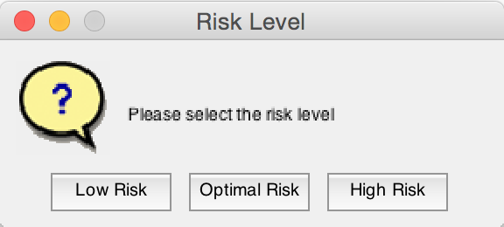
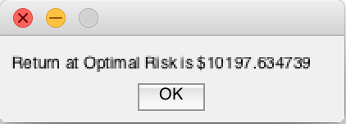
Graphical User Interface

Slide 6
Matlab Code:
Comparing solvers: QuadProg Vs fmincom
QuadProg : Fast, efficient
Can handle non linear objective functions
Cannot take non linear constraints
Fmincon : Can take non linear constraints & objective functions
Multiple choice of algorithms available
(interior point, sequential quadratic programing etc.)
Handles sparse matrix, NaN & infinity problems very well
Assigned infinitely small weights (10⁻⁴) to all stock

Slide 7
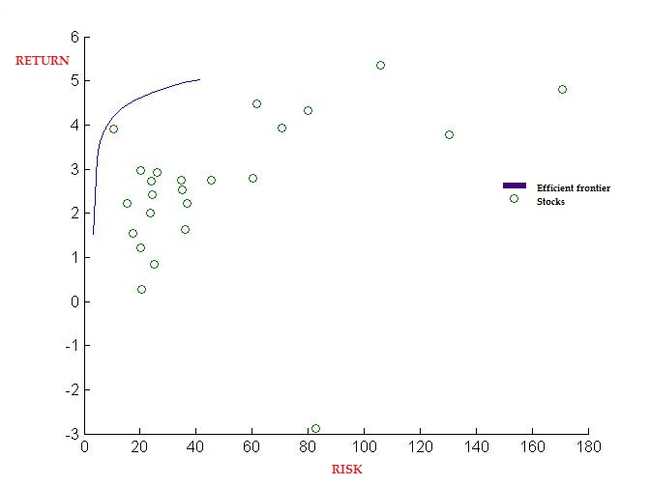
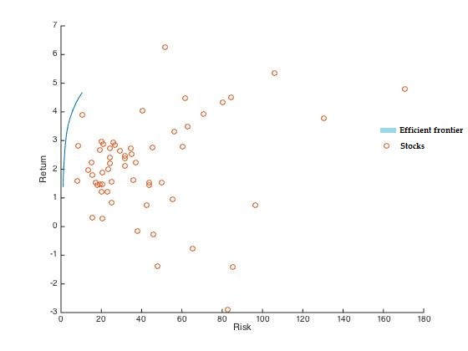
Stock Placement with Efficiency frontier

Slide 8
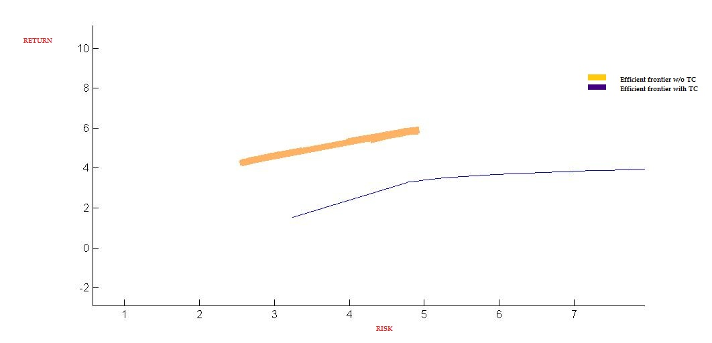
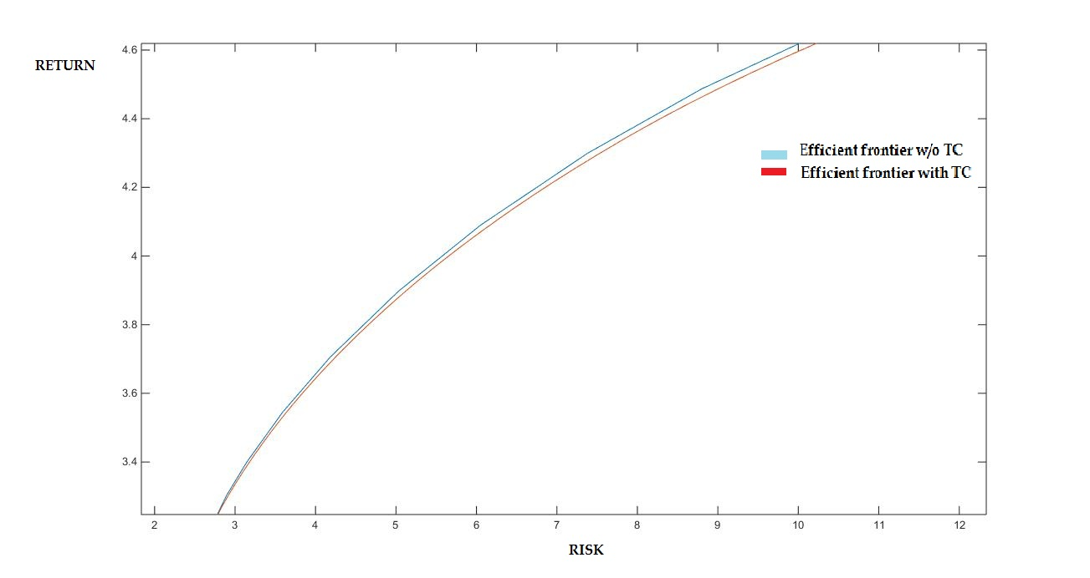
Optimization with and without Transaction costs

Slide 9
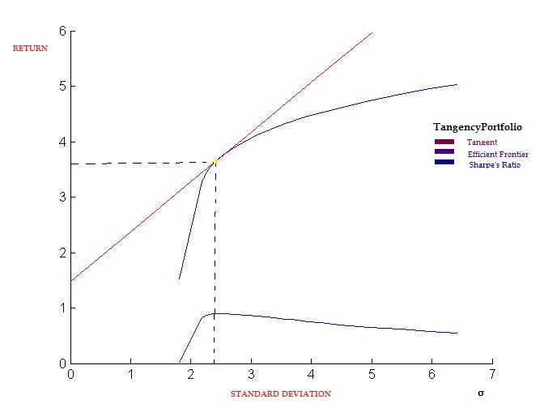
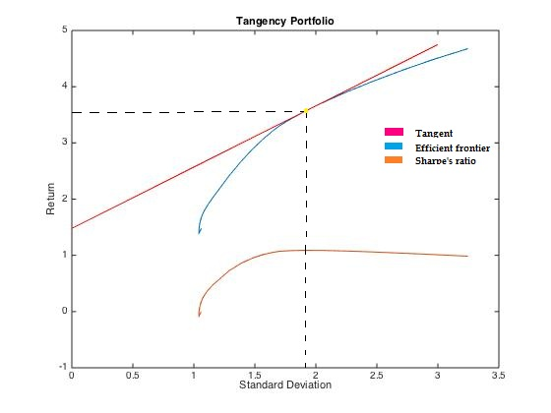
Efficiency frontier & Sharpe’s Ratio 24 Stocks Portfolio 60 Stocks Portfolio

Slide 10
Insights from intLingprog
Reduced return with 60 stocks
Number of stocks | Returns | Best stock
10 | 6.16% | Southwest Airlines
30 | 5.81% | Southwest Airlines
60 | 5.01% | Southwest Airlines

Slide 11
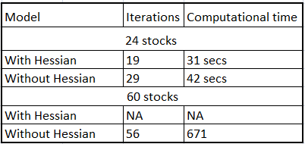
Scalability – Increasing No. of Assets

Slide 12
Code Enhancements
Parallelism in code
Experimenting with different algorithms like Active Set & Trust-Region in fmincon
Scaling it to a multi-period model by rebalancing portfolio at a certain time step.
Terminating the iterations after the Sharpe’s ratio stabilizes or starts decreasing.
Adding real world constraints such as currency exchange and inflation effects

Slide 13
Work Division
Akshata & Sumit: Optimization Model, Interpretations & Documentation
Amol & Harshvardhan: Data collection and model implementation in MATLAB.

Slide 14
Thank you!
We welcome your questions
☺
Or do we…

